Slide 1


BASIC SOLUTION
300-2000 IPC
Tiandy Overseas

Slide 2
CONTENTS
01
BACKGROUND
02
SYSTEM STRUCTURE
03
PRODUCT SELECTION
04
ADVANTAGES

Slide 3
CONTENTS
01
BACKGROUND

Slide 4

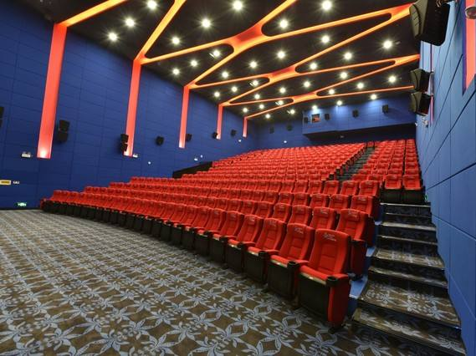


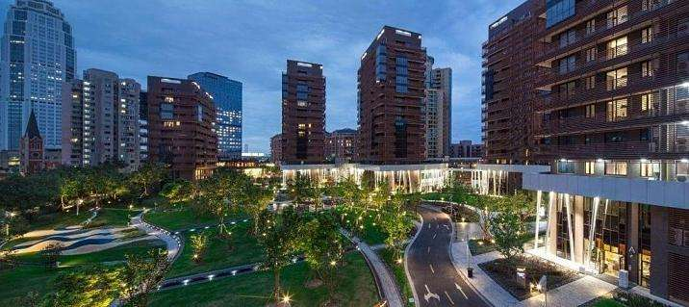
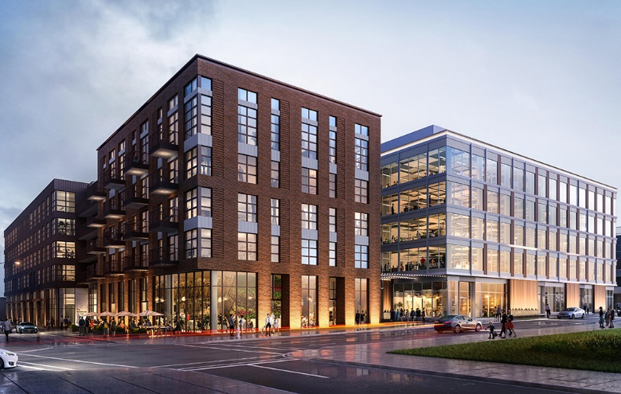
For a large scenario surveillance, which products are necessary?
Chain retrial store
Chain theater
Multiple scenic spots
Public place
Multiple communities
Multiple office buildings

Slide 5


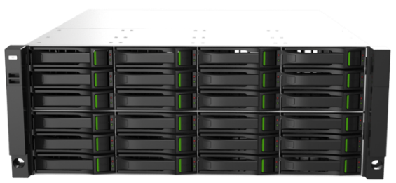


WHICH FACTOR AFFECTS OUR CHOICE OF SOLUTIONS MORE？
CMS server
Client
Storage
Center
K2000
HDMI
Streaming media server
Decoder
Display
Why the system needs so many equipments?
Our sales team don’t know how to choose storage equipment, what should we do?
Our sales team don’t know when the streaming server is needed, what should we do?
Our sales team don’t know how to choose video wall decoder, what should we do?

Slide 6
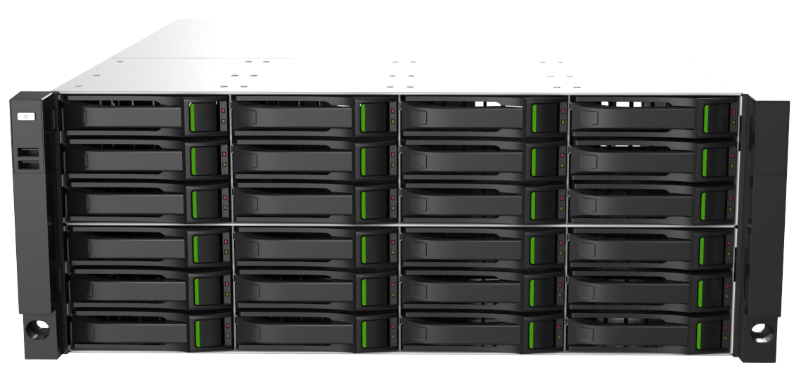
Key features of K2000
Appearance
Interface
4U height, front install 24 HDD, build-in indicator
Front-in 2*USB, back-in 2*USB 3.0 . 2*HDMI, 1*VGA, 4*1000Mb Ethernet ports, 1*RS232, Alarm I/O 8/4
Bandwidth
Security mechanism
Video input bandwidth 512MB, storage bandwidth 512MB, support 256-ch 2MP recording at the same time
Standard power supply, support redundant power supply
Support RAID0/1/5/6/10/50/60, efficiently ensure data security

Slide 7
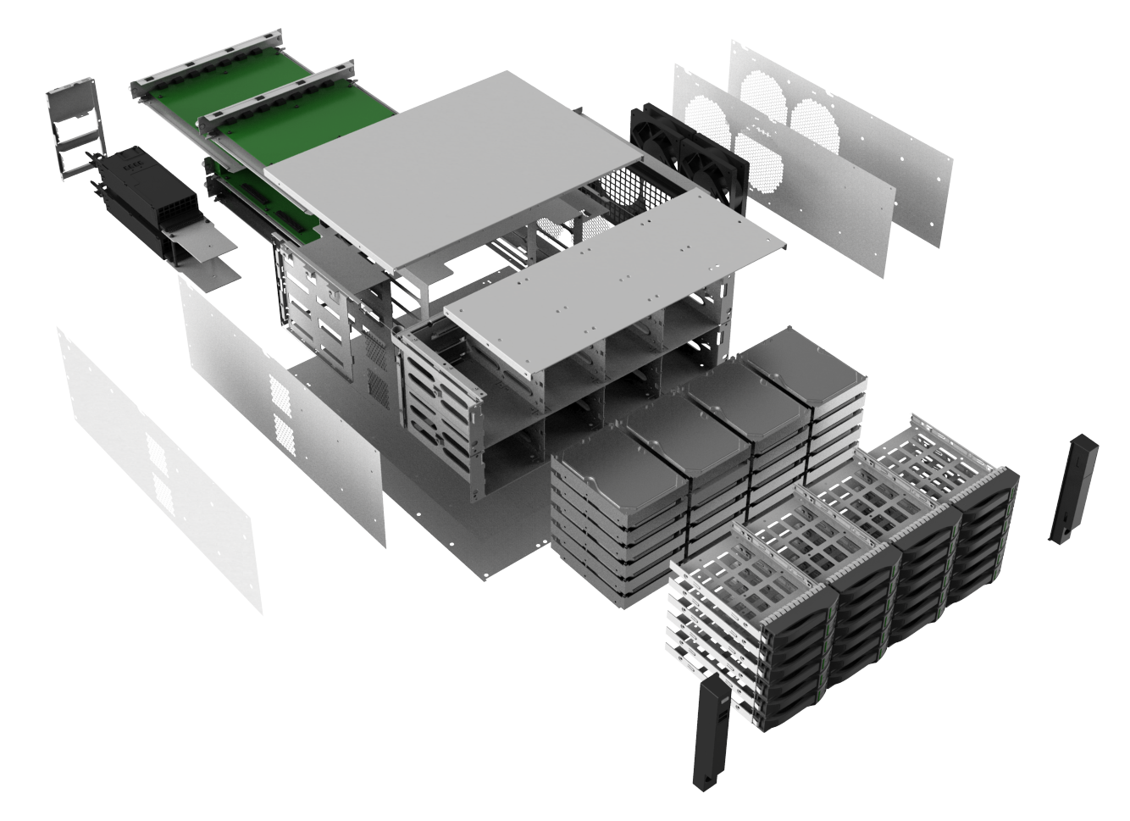
Key features of K2000
Powerful design
All hardware modular
Wireless cables
“Permeable" heat
Dissipation design
Escort the hard drive

Slide 8
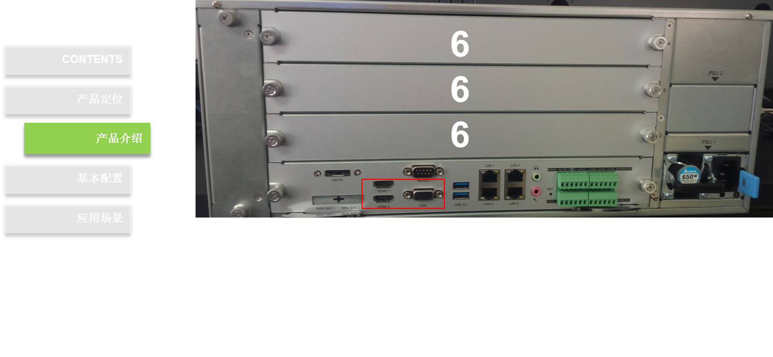
Key features of K2000
Powerful decoding ability
Decoding ability
Support 3 decoder boards, maximum support to connect with 21 screens, support video output up to 160-ch*1080p
3 build-in video output interface, 2 of them are simultaneous. Support to connect with 2 screens, video output 16-ch*1080p

Slide 9
CONTENTS
02
SYSTEM STRUCTURE

Slide 10
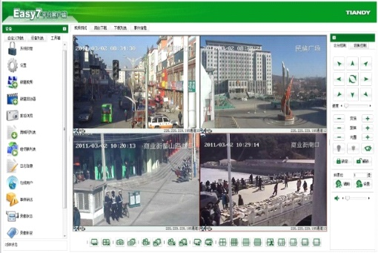
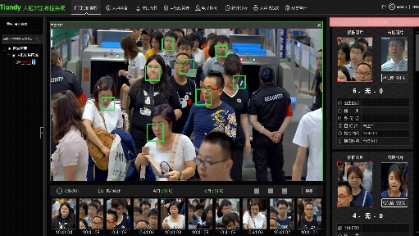
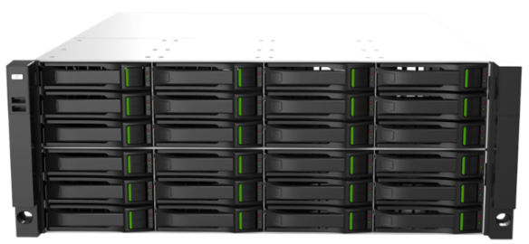

Stand-alone management system structure
Stand-alone system structure
Switch
Switch
Camera
K2000
AI camera
light
light

Slide 11
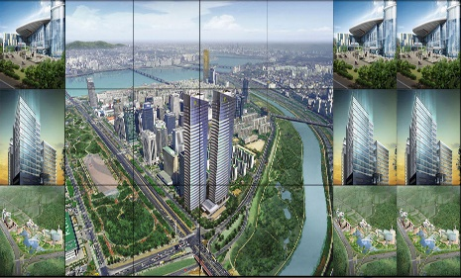


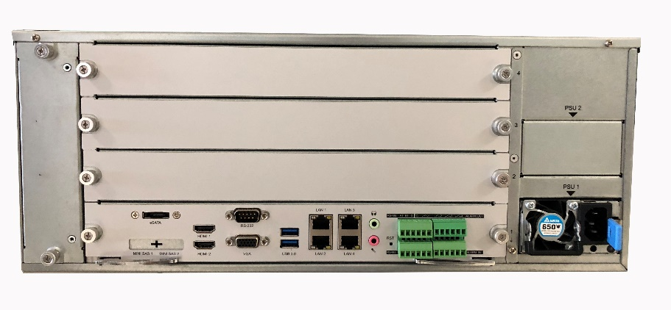
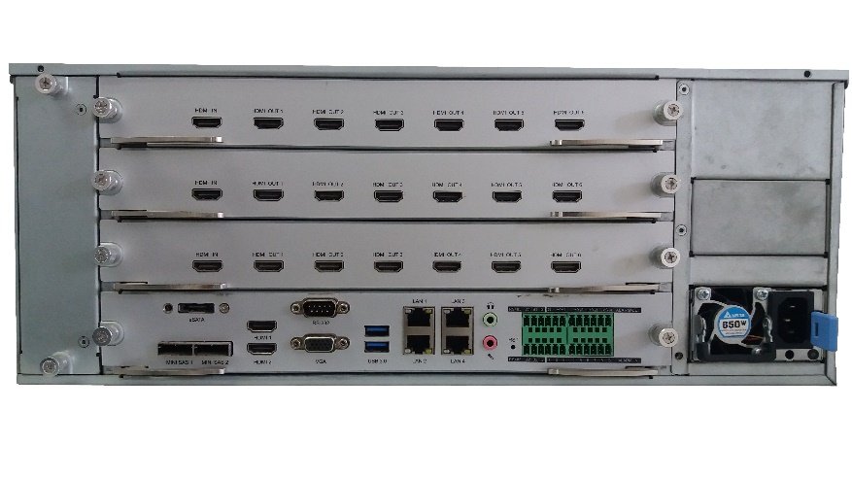
Stand-alone management system structure
Stand-alone video wall control
LCD 1
LCD 2
HDMI1
HDMI2
Built-in 2-screen 16-channel 1080p decoding capability.
The function of simple combination and control can be realized.
3 decode boards can be inserted, each with 1 in and 6 out.
Expand to a maximum of 20 screens, 160 channels, 1080p.
Decoding board model: TC-ND926S5-C
Notes:
系统功能7-解码拼控
K2000自带一块解码板，自带2屏16路1080P解码能力，可实现解码功能和简单的拼控功能
同时，支持扩展3块解码板，每块解码板提供一个输入口，可将一台电脑屏幕投上屏幕，6个输出口，可将视频解码上墙

Slide 12
Stand-alone management system structure
01
02
03
All-round management
High video-input capacity
Powerful video wall control
High bandwidth capacity: up to 512Mbps
Intel processor 64 bit, RAM 8GB,video input 256-ch*2MP
Integration with storage, decoder, video wall controller, alarm and intelligence. Easy to install.
NVR could be connected with 21 screens, display 160-ch 1080p video stream
06
05
04
Remote decoding
Strong intelligence
Stable system
Centralized video wall management, remote control decoding
Checkpoint management
27 VCA management
RAID
1+1 redundant power

Slide 13
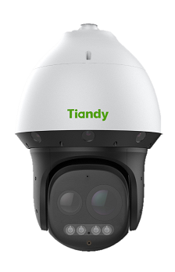
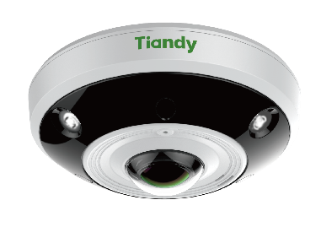
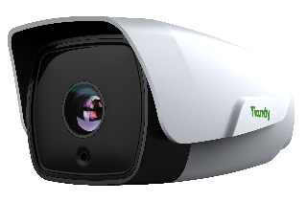
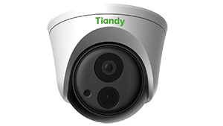
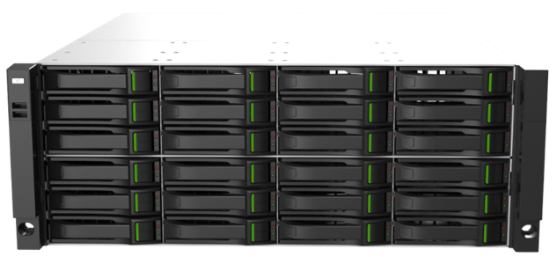
Centralized management system structure
Centralized management alarm
…...
Switch
Support various types of front-end equipment access, bullet, dome, fisheye, PTZ, etc.
Support management alarm from front-end

Slide 14
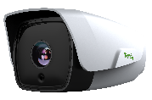
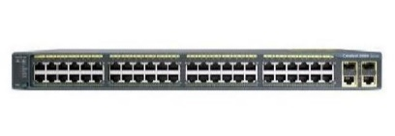

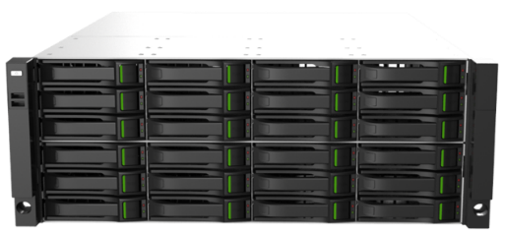
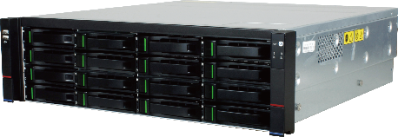
Centralized management system structure
Centralized management storage
250ch
New camera
NVR
CVR
K2000
Storage expansion
The camera is preferentially connected to NVR or centralized storage, and then NVR is connected to K2000 for unified management to solve the problem of limited self-storage.
Notes:
系统功能6-任意扩容
很多客户可能会问，如果存储空间不够怎么办？
系统支持存储扩容，前端设备优先接入NVR或集中存储中，再将NVR或者集中存储接入K2000进行统一管理，解决自身存储有限的问题。

Slide 15



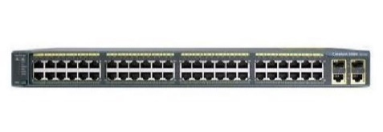
Centralized management system structure
Centralized management video wall
Sub-center TV wall 1
Central TV wall
Sub-center TV wall 2
Decoder
Decoder
K2000 can be connected to the decoder to realize the center-sub-center hierarchical structure management.
Notes:
系统功能8-异地解码
K2000解决方案推荐K2000放置在监控中心，方便解码上墙
但是存在某些现场，K2000放置地点和监控中心不在一起，或者某些现场有中心、分中心等监控中心，想要实现异地上墙，怎么办？
K2000可接入解码器，实现中心-分中心层级结构管理

Slide 16
Centralized management system structure
Alarm management
Storage control
Video wall control
K2000
K2000 is able to connect with various types of front-end and manage alarm at once.
K2000 could manage storage from different devices and expand local storage.
K2000 support centralized video wall control, which allows controlling whole situation

Slide 17
CONTENTS
03
HOW TO SELECT PRODUCTS

Slide 18
IPC: Box, Bullet, Turret, Dome
How to select IPC
Appearance
PTZ: 3-inch, 4-inch, 6-inch, 9-inch, 10-inch
Scenario – Indoor/Outdoor
Working condition – Temperature/Humidity
Totally new requirement
Application
Monitoring effect
Lens, illumination, WDR, supplement
Normal smart function
Tripwire, double tripwire, motion…
Functions
Special smart function
LPR, face recognition, people counting
Customization
Other options instead of customization?
Client’s requirement
Communicate with R&D team.
Get to know the original requirement
There are analogous models
Find the core index
Get to know product carefully
Require for replacing products
Find the core index
There aren’t analogous models
Ask for help
Product team, R&D team
Make a Choice – Expectation of sales
Require for Integration
Integrator
Have a discussion with R&D team

Slide 19
How to select transmission product
Select bandwidth by number of channels IPC or position in system
Select PoE or Non-PoE by requirement of supply
Switch
Select Ethernet or SFP by distance of transmission
Select Network management switch or Unmanaged switch by requirement
Client’s requirement
Select model by distance of transmission
Wireless bridge
Select model by covered range
Ethernet cable
CAT5e/CAT6/CAT6e

Slide 20
Network interface: PoE/Non-PoE; Limited bandwidth
How to select NVR
Interface
Alarm I/O; Video I/O; Audio I/O
Limited video I/O: channel, resolution, decoding capacity
Storage: amount of HDD; capacity of each HDD
Totally new requirement
Application
Monitoring effect
Lens, illumination, WDR, supplement
Normal smart function
Tripwire, double tripwire, motion…
Functions
Special smart function
LPR, face recognition, people counting
Customization
Other options instead of customization?
Client’s requirement
Communicate with R&D team.
Get to know the original requirement
There are analogous models
Find the core index
Get to know product carefully
Require for replacing products
Find the core index
There aren’t analogous models
Ask for help
Product team, R&D team
Make a Choice – Expectation of sales
Require for Integration
Integrator
Have a discussion with R&D team

Slide 21
How to select
video wall devices
Amount of channels (video input)
Bandwidth (video input)
Amount of screens (video output)
Decoder
Amount of split screens (video output)
Video wall controller
Interface type of screens (video output) HDMI/VGA/DVI/YCbCr
Video resolution (video output)
Amount of video resources
Amount of video input boards
Video resolution
Interface type of screens (video output)
Screen
controller
Amount of screens
Amount of video input boards
Video resolution
Client’s requirement
Interface type of screens (video output)
Keyboard
Amount of decoders
Amount of controller
Monitor
Installation, spilt screen, resolution, diagonal size
Screen
LCD screen
Installation, spilt screen, resolution, diagonal size, physical seam
LED screen
Installation, spilt screen, resolution, diagonal size, physical seam

Slide 22
CONTENTS
04
ADVANTAGES

Slide 23
ADVANTAGES
Centralized system
Centralized management
Easy Control
Management video live view
Remote control whole system
Management video storage
Modular structure, easy to control
Management alarm
Powerful database
Management intelligent functions
High compatibility
Management early warning
High stability
Management video wall
Control multi-sites at the same time
Management face recognition system
……
Management LPR system
Management people counting system
……

Slide 24
ADVANTAGES
Stand-alone system
All-in-one management
Stable design
RAID technology
Redundant power supply
Management video live view
Economic solution
Reduce amount of equipment，reduce cost
All-in-one design, reduce the maintenance cost
Build-in storage sever, improve stability of safety
Easy configuration & installation, reduce cost of workers
……
Management video storage
Management alarm
Management intelligent functions
Management early warning
Management face recognition system
Management LPR system
Management people counting system
……

Slide 25
BASIC SOLUTION
300-2000 IPC
Tiandy Overseas
Notes:
更多精品素材：http://shop248912786.taobao.com/index.htm （下拉可隐藏）

